Slide 1
컴퓨터 네트워크 Computer Networks and Internets, 6e

Slide 2
Review
Information (Signal) to Signal
Analog to Analog
; Modulation (Demodulation) - MODEM
Analog to Digital
; PCM
Digital to Analog
; Shift Keying (Modulation)
Digital to Digital
; Line (Coding) - CODEC
© Pearson Education Inc., Upper Saddle River, NJ. All rights reserved.
2
Notes:
2

Slide 3
Chapter 11 Multiplexing and Demultiplexing (Channelization)

Slide 4
11.1 Introduction
This chapter
continues the discussion of data communications by introducing multiplexing
describes the motivation
defines basic types of multiplexing that are used throughout computer networks and the Internet
explains how modulated carriers provide the basis for many multiplexing mechanisms

Slide 5
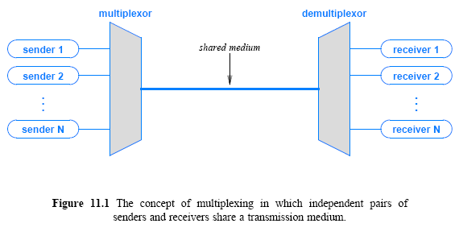
11.2 The Concept of Multiplexing

Slide 6
11.3 The Basic Types of Multiplexing
There are four basic approaches to multiplexing that each have a set of variations and implementations
Frequency Division Multiplexing (FDM)
Wavelength Division Multiplexing (WDM)
Time Division Multiplexing (TDM)
Code Division Multiplexing (CDM)
TDM and FDM are widely used
WDM is a form of FDM used for optical fiber
CDM is a mathematical approach used in cell phone mechanisms

Slide 7
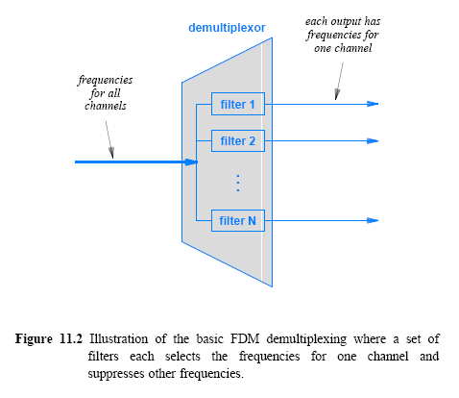
11.4 Frequency Division Multiplexing

Slide 8
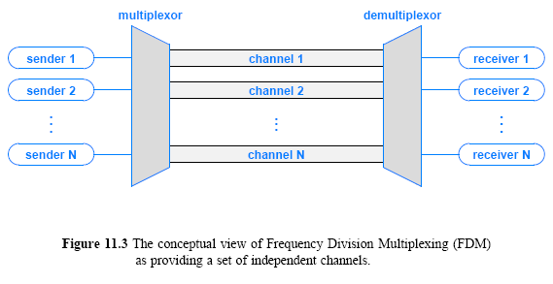
11.4 Frequency Division Multiplexing

Slide 9
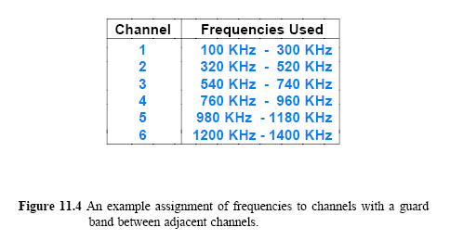
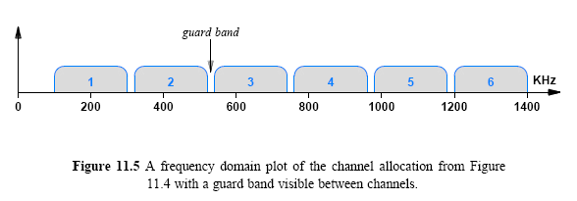
11.4 Frequency Division Multiplexing

Slide 10
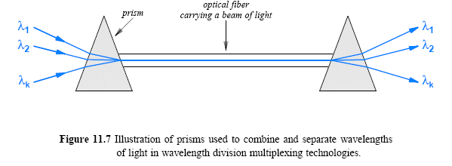
11.7 Wavelength Division Multiplexing
Form of FDM used with light (i.e., on an optical fiber)
Separate frequencies called colors or lambdas
Prisms used to separate frequencies
Current technology is Dense WDM (DWDM); an individual
channel can provide 10 Gbps

Slide 11
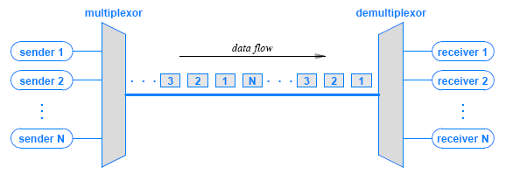
11.8 Time Division Multiplexing (TDM)
multiplexing in time simply means transmitting an item from one source, then transmitting an item from another source, and so on

Slide 12
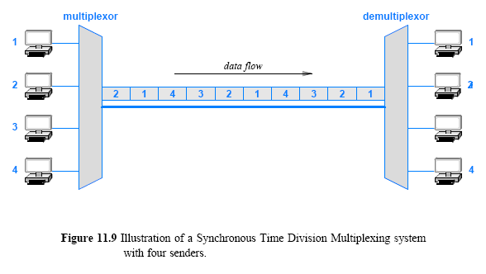
11.9 Synchronous TDM

Slide 13
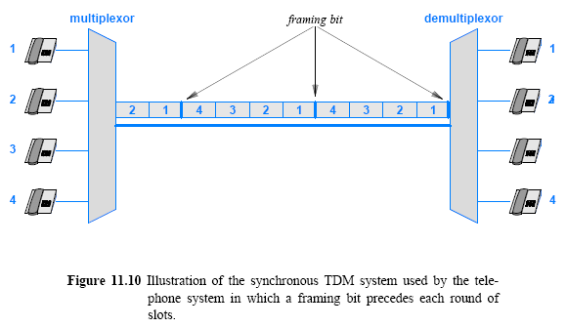
11.10 Framing Used in the Telephone System Version of TDM

Slide 14
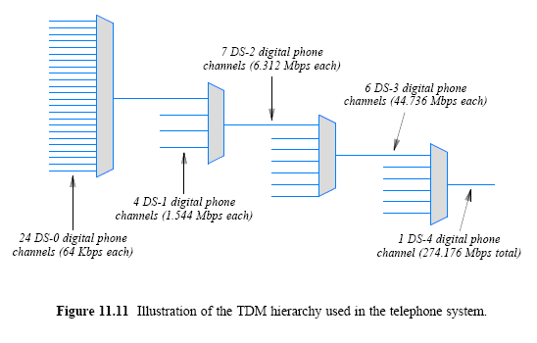
Hierarchical TDM (data rates of Leased Circuits: T-standard)
basic rate T1(24) T2(96) T3(672)

Slide 15
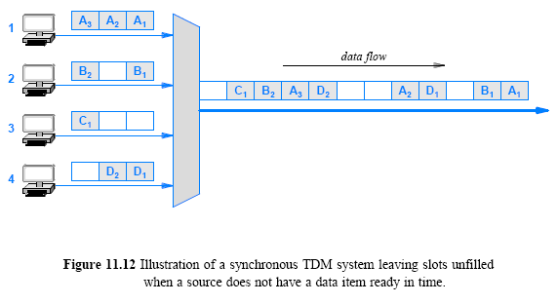
11.12 The Problem with Synchronous TDM: Unfilled Slots

Slide 16
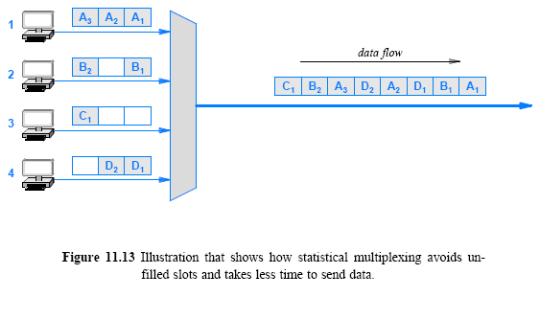
11.13 Statistical TDM

Slide 17
11.15 Code Division Multiplexing (CDM)
CDM used in parts of the cellular telephone system and for some satellite communication
The specific version of CDM used in cell phones is known as Code Division Multi-Access (CDMA)
CDM relies on an interesting mathematical idea
Each sender is assigned a unique binary code C_{i}
that is known as a chip sequence
Senders multiply the data value by their chip sequence
Transmitted value is a sum of all senders
Each receiver multiplies incoming value by its chip sequence to extract data
Advantage over statistical TDM: lower delay when network loaded

Slide 18
Chapter 12 Access and Interconnection Technologies
© Pearson Education Inc., Upper Saddle River, NJ. All rights reserved.
18
Notes:
18

Slide 19
Review
Multiplxesing
TDM
Synchronous, Statistical
FDM
CDM
Solving Assignment
© Pearson Education Inc., Upper Saddle River, NJ. All rights reserved.
19
Notes:
19

Slide 20
12.1 Introduction
This chapter
concludes the discussion of data communications by examining two facilities used in the Internet
discusses access technologies, such as dialup, DSL, and cable modems
considers high-capacity digital circuits used in the core of the Internet
expands the discussion of the telephone system multiplexing hierarchy
focuses on the data communications aspects of the technologies by considering multiplexing and data rates
© Pearson Education Inc., Upper Saddle River, NJ. All rights reserved.
20
Notes:
20

Slide 21
12.2 Internet Access Technology: Upstream and Downstream
Internet access technology refers to a data communications system that connects an Internet subscriber to an ISP
such as a telephone company or cable company
Most Internet users follow an asymmetric pattern
a subscriber receives more data from the Internet than sending
a browser sends a URL that comprises a few bytes
in response, a web server sends content
Downstream to refer to data traveling from an ISP in the Internet to a subscriber
Upstream to refer to data traveling from a subscriber to an ISP
© Pearson Education Inc., Upper Saddle River, NJ. All rights reserved.
21
Notes:
21

Slide 22
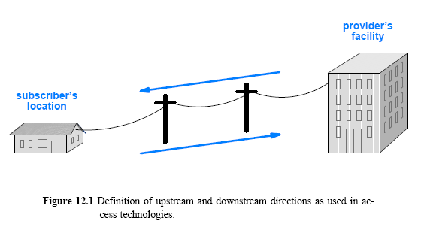
12.2 Internet Access Technology: Upstream and Downstream
© Pearson Education Inc., Upper Saddle River, NJ. All rights reserved.
22
Notes:
22

Slide 23
12.3 Narrowband and Broadband Access Technologies
A variety of technologies are used for Internet access
They can be divided into two broad categories based on the data rate they provide
Narrowband (less than 128Kbps) ; Dialup, ISDN, is disappearing
Broadband (more than 1Mbps) ; DSL, Cable Modems, Wireless
In networking terms, network bandwidth refers to data rate
© Pearson Education Inc., Upper Saddle River, NJ. All rights reserved.
23
Notes:
23

Slide 24
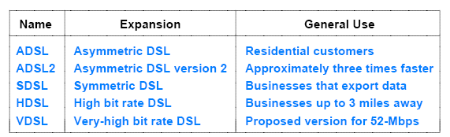
12.5 Digital Subscriber Line (DSL) Technologies
DSL is one of the main technologies used to provide high-speed data communication services over a local loop
Figure 12.4 (below) lists DSL variants
Because the names differ only in the first word, the set is collectively referred to by the acronym xDSL
© Pearson Education Inc., Upper Saddle River, NJ. All rights reserved.
24
Notes:
24

Slide 25
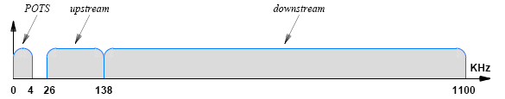
12.5 Digital Subscriber Line (DSL) Technologies
ADSL is the most widely deployed variant
and the one that most residential customers use
ADSL uses FDM to divide the bandwidth of the local loop into three regions
one of the regions corresponds to traditional analog phone service, which is known as Plain Old Telephone Service (POTS)
two regions provide data communication: 255 downstream,31 up
Figure 12.5 (below) illustrates how ADSL divides bandwidth
© Pearson Education Inc., Upper Saddle River, NJ. All rights reserved.
25
Notes:
25

Slide 26
12.9 Cable Modem Technologies
A variety of wireless and wired technologies have been developed for use in the local loop
Send data over Community Antenna TeleVision (CATV) coaxial cable system
Standard is DOCSIS (Data-Over-Cable Service Interface Specification)
Ver. 1.x uses FDM to deliver TV signals over coaxial cable
Coaxial cable has high bandwidth and is less susceptible to electromagnetic interference than twisted pair
Max. downstream rate is 52Mbps
Bandwidth shared among multiple subscribers
Each subscriber receives 1/N of the bandwidth
© Pearson Education Inc., Upper Saddle River, NJ. All rights reserved.
26
Notes:
26

Slide 27
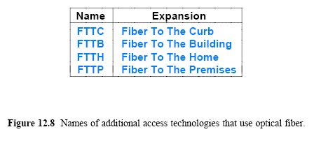
12.13 Access Technologies That Employ Optical Fiber
HFC(Hybrid Fiber Coax) can provide high-speed data communications
a HFC system uses a combination of optical fibers and coaxial cables
Other access technologies
© Pearson Education Inc., Upper Saddle River, NJ. All rights reserved.
27
Notes:
27

Slide 28
Other Access Technologies
Network (Ethernet)
Wireless
– Wi-Fi
– WIMAX
– Satellite
3G and 4G cellular services
Leased point-to-point circuits (e.g., T1 or fractional T1)
© Pearson Education Inc., Upper Saddle River, NJ. All rights reserved.
28
Notes:
28

Slide 29


















A closer look at network structure:
network edge:
hosts: clients and servers
servers often in data centers
mobile network
global ISP
access networks, physical media: wired, wireless communication links
home
network
regional ISP
network core:
interconnected routers
network of networks
institutional
network

Slide 30
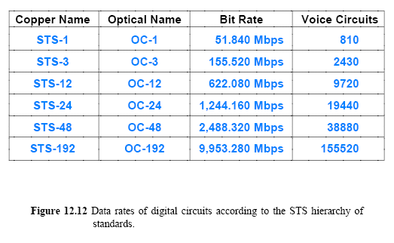
12.20 Highest Capacity Data Circuits
STS standards specify copper interface
OC standards specify optical fiber interface
Suffix C on OC-standards means single channel
© Pearson Education Inc., Upper Saddle River, NJ. All rights reserved.
30
Notes:
30

Slide 31
Assignment
1. We need to use synchronous TDM and combine 10 digital sources, each of 800bps. Each output slot carries 8 bits from each source, but one extra bit(framing bit) is added to each frame.
a) what is the size of an output frame in bits?
b) What is the output data rate(bps)?
2. Compare the throughput of the following transmissions.
a) parallel vs. serial b) FDM vs. TDM
c) full-duplex vs. half-duplex d) synchronous vs. asynchronous
3. Explain the multiplexing method used in ADSL.
Send your solution to me by email. (Due date: 4.11. )
This assignment will be used to check your attendance.
© Pearson Education Inc., Upper Saddle River, NJ. All rights reserved.
31
Notes:
31

